Slide 1
Communication Tools
Iteration 1
Team 3

Slide 2
Stricter Password Requirement
Requirements:
Only passwords are accepted with the following criteria: at least 8 characters using at least one uppercase letter, one lowercase letter, and one number.
Implementation:
RegEx to test that password meets required criteria and throw error message to frontend to be displayed if it doesn’t.
Regex used: r'^(?=.*[A-Z])(?=.*[a-z])(?=.*[0-9]).{8,}$'

Slide 3
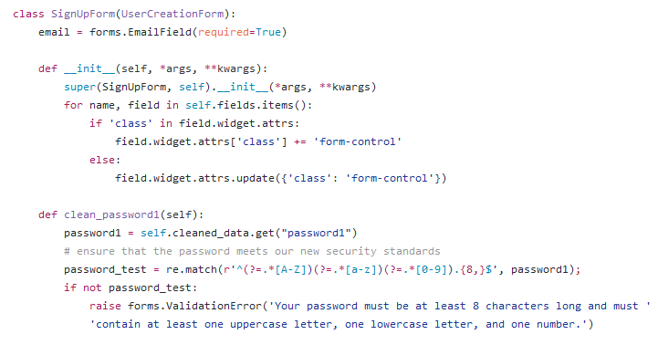
Code Sample - Password Requirements

Slide 4
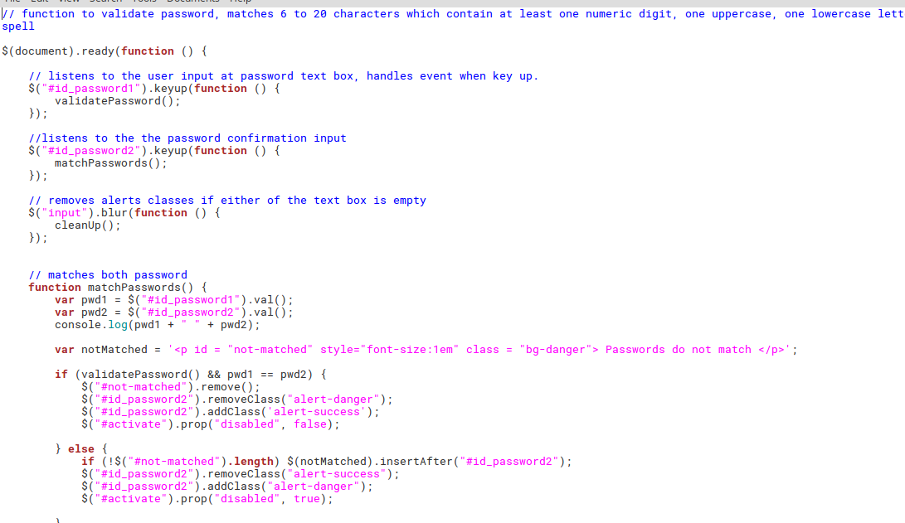
Password Matcher Code

Slide 5
Password Matcher
Requirements
Sign up button should be disabled and show passwords doesn’t match until both password entries matches.
Implementation
Added jquery code to match both password and display whether they match or not.

Slide 6
Fixed file upload bug
Requirements
File Upload function in communication tools should not crash when using it.
Implementation
Fixed every relative and added node js modules to detect the overlying Operating system and create paths accordingly.

Slide 7
Fixed Site Grammar
Requirements:
Flavor text in the application uses correct grammar.
Flavor text in the application is free from spelling mistakes.
Implementation:
Edited client-facing text in HTML to improve English grammar and overall user experience.

Slide 8
Delete Old Messages
Requirements:
Delete oldest messages if a room has reached more than 5,000 messages
Write unit test proving messages get deleted after limit is reached
Implementation:
Receiver function in models that listen for a save signal when a message is saved to database
Test:
Add 5,100 messages to a room. Room should have 5,000.

Slide 9
Fix Unit Tests + Selenium Tests
Requirements
All Unit Tests Pass
All Selenium Tests Pass
Documentation
Implementation
Debug WebDriver Issues
Debug GeckoDriver binary Issue
Debug Database issues (big one)
Fix broken tests one by one
Delete tests that tested non-existing code
Documentation

Slide 10
Fix Duplicate Messages
Requirements:
Make sure each message be sent once. And only shown once in the screen.
Implementation:
Fixed NodeJS code so that messages wouldn’t be duplicated and sent twice.

Slide 11
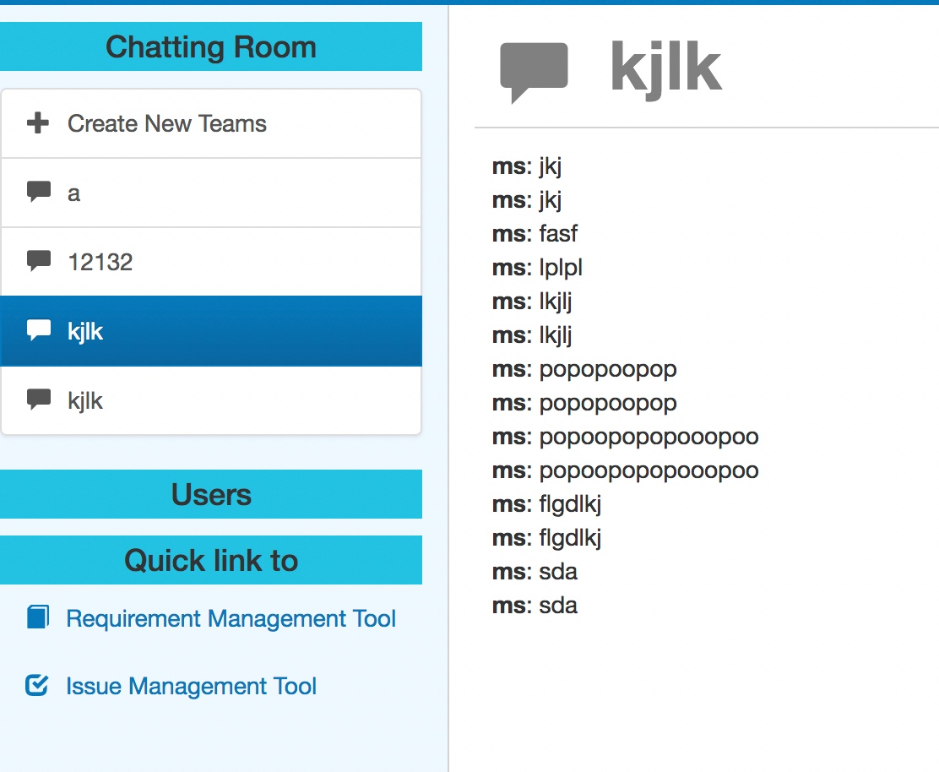
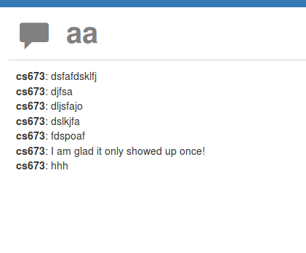
Duplicate Issue

Slide 12
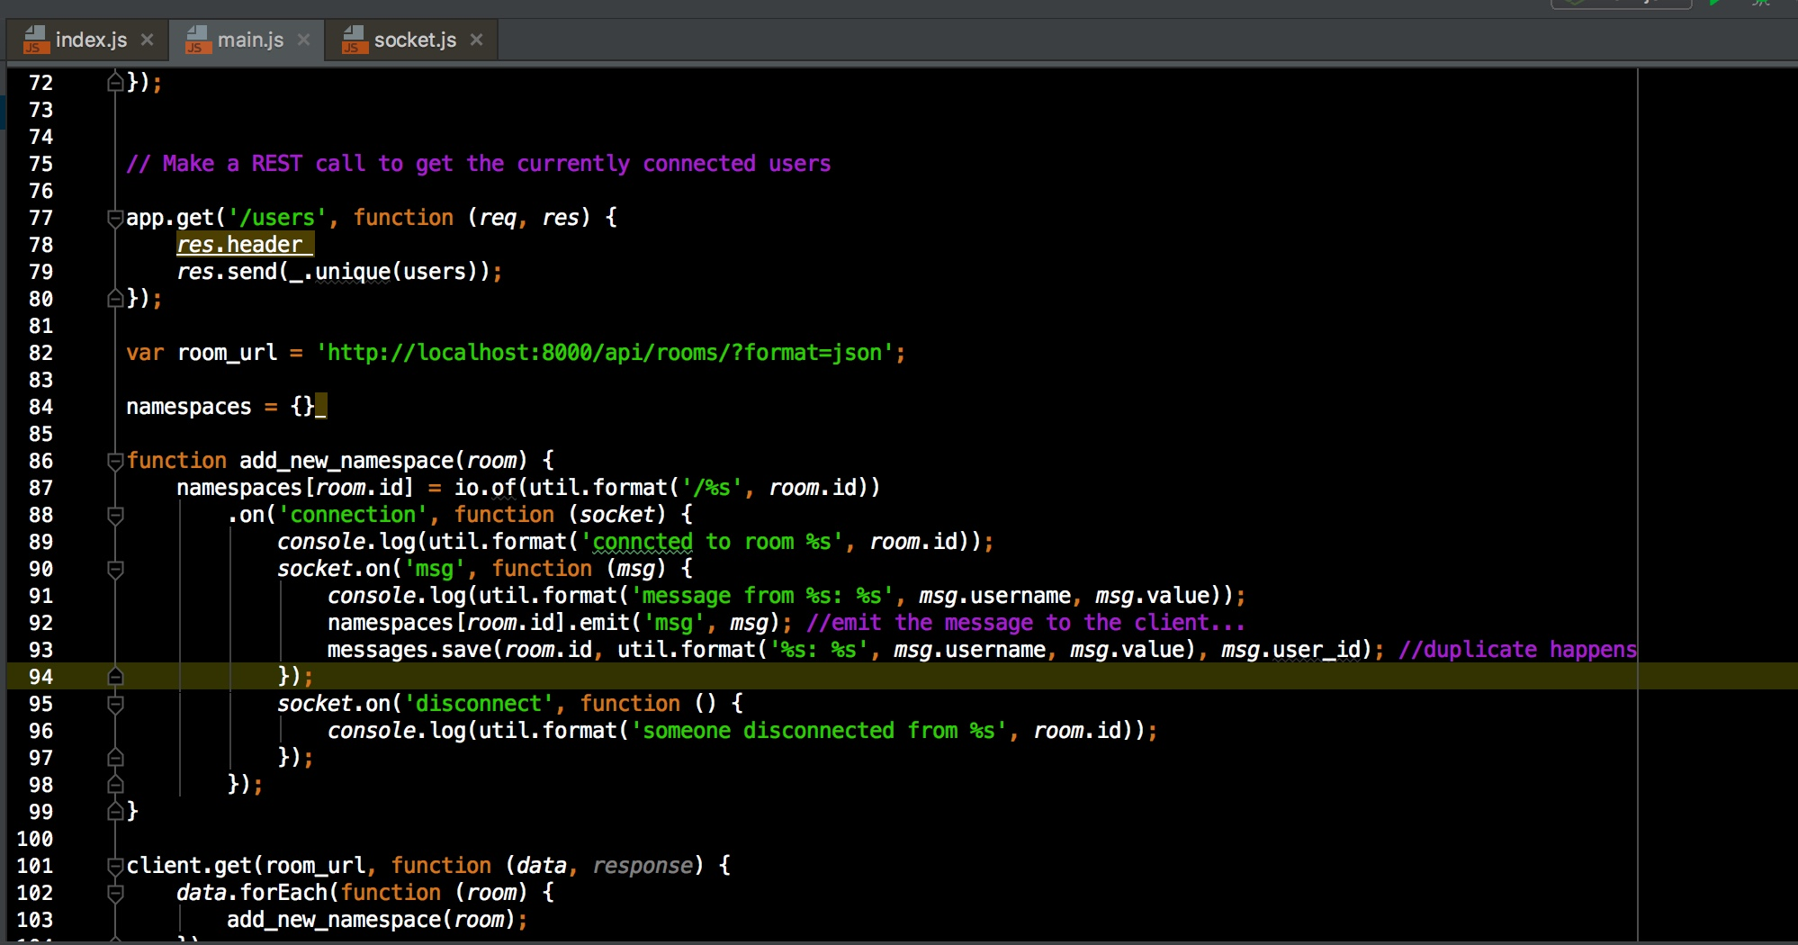
Source Code - WebSocket

Slide 13
Revise the GitHub Instructions
Requirements:
Users of the repository will be able to follow the instructions and setup the application successfully.
Implementation:
Add the usage part so users we will be able to see if they have successfully set up the application.
Combine the Django and Node server to make the instructions more concise and clear.

Slide 14
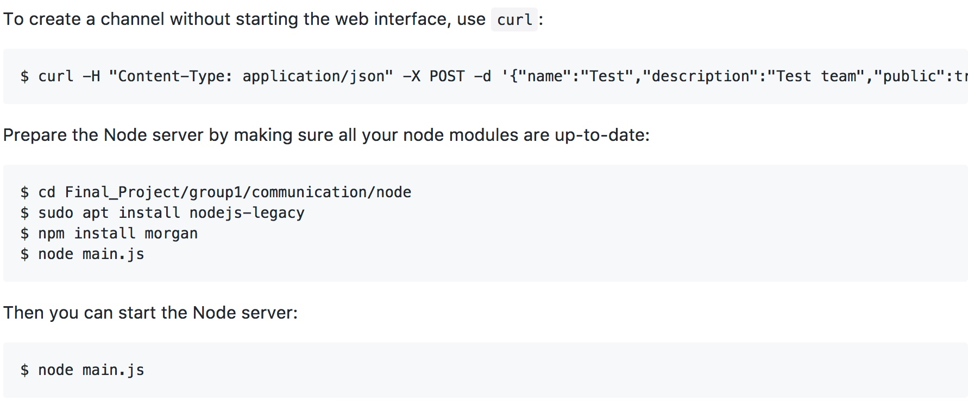
GitHub Revision

Slide 15
Team Reorganization
Requirements
Team 2 Team needed a Team Lead
Efficient Communication
Efficient workflow
Smaller teams
Implementation
Re-organized Team members into sub-teams, with their own team lead
Smaller teams = more efficient workflow & easier communication
Sub Team Leads have stepped up and set an example :)

Slide 16
Architecture Diagrams and File System Overview
Requirements
Make it easy to understand how the application is structured
Make it easy to understand how the file system is organized
Implementation
Architecture entity diagrams with control flow
File System diagram with notes on important files

Slide 17
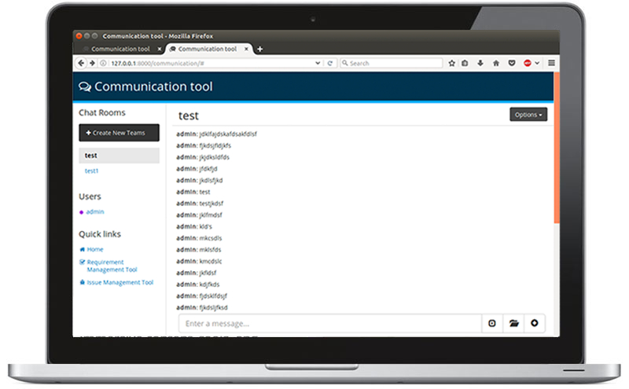
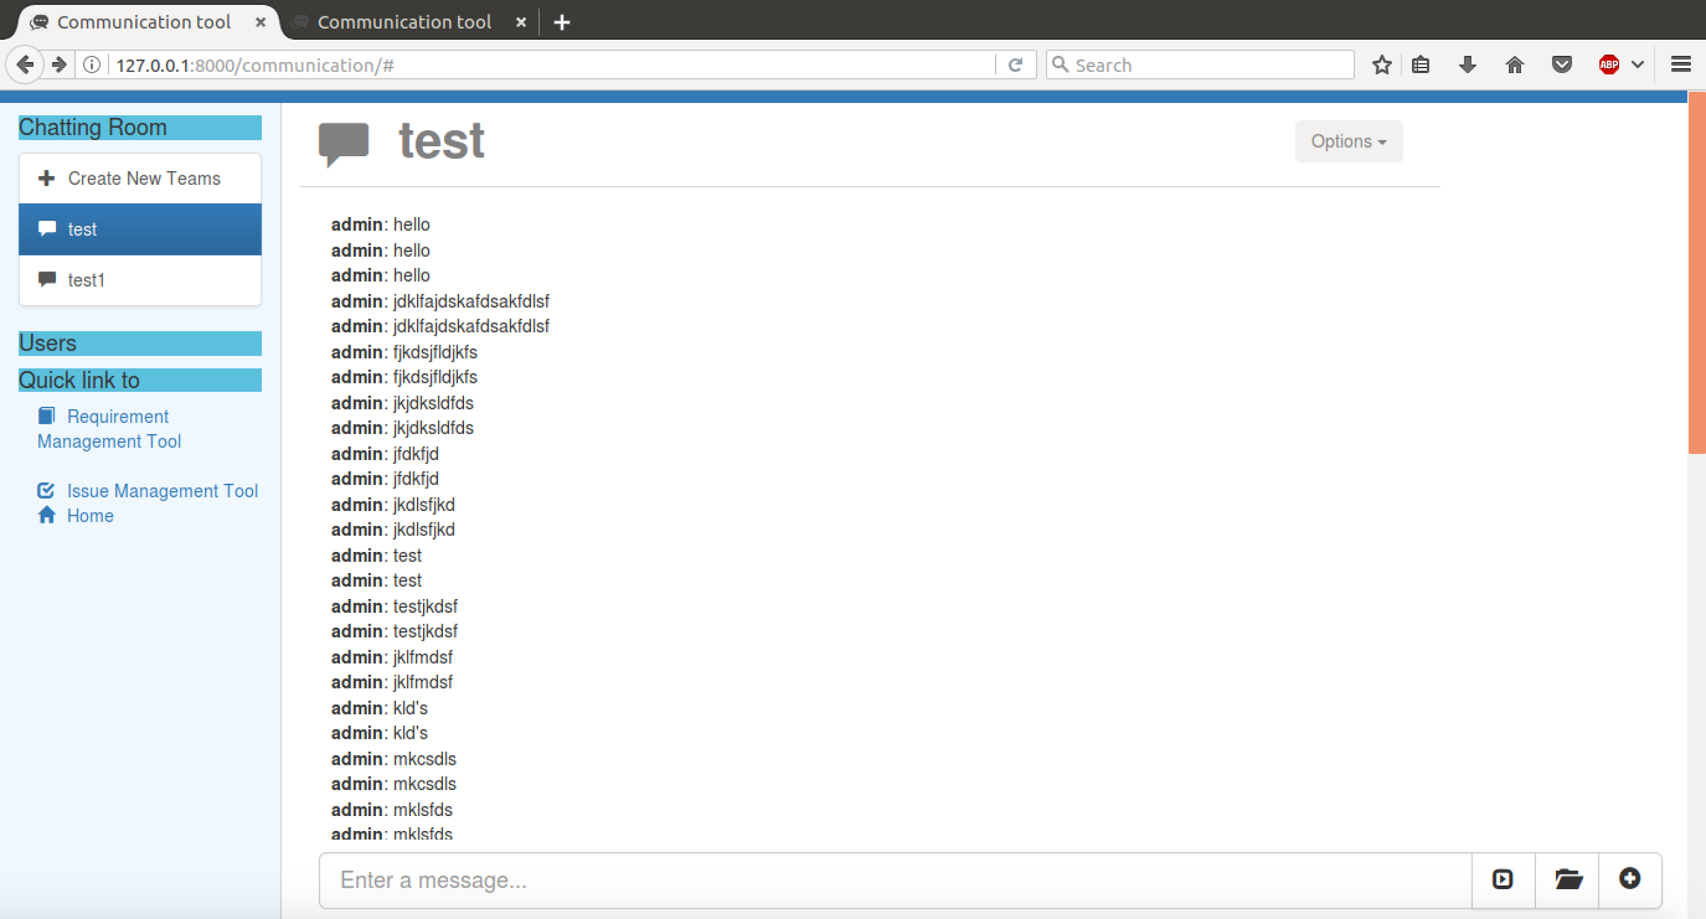
Updated Design
Old design

